Slide 1
Chapter Four
Network Layer: Addressing and Routing

Slide 2
Network Layer
It is responsible for the source to destination delivery of a packet across multiple networks.
If two systems are attached to different networks with devices like routers, then network layer is used.
Routers (layer-3 devices) are specified at the Network layer and provide the routing services within an internetwork.
Thus Data link layer overseas the delivery of the packet between the two systems on same network and the network layer ensures that the packet gets its point of origin to its final destination.

Slide 3
Basic operations/ functions of the network layer
Logical addressing
If a packet passes the network boundary, we need another addressing system to help distinguish the source and destination systems.
The network layer adds a header to the packet coming from the upper layer that, among other things, includes the logical addresses of the sender and receiver.

Slide 4
Cont..
Routing
Routing is method to route a data packet from source to destination.
It is determined by the hope count, the bandwidth of the path.
When independent networks or links are connected to create internetworks (network of networks) or a large network, the connecting devices (called routers) route the packets to their final destination.
.

Slide 5
Cont..
For example : when you want to access some data from Facebook, you open your laptop, type Facebook URL and send request to Facebook for some data.
Since Facebook server is outside your local area network , your request is forward to Facebook through the default gateway or router of your institution.
This forwarding of data request to the server or user is known as routing.

Slide 6
Cont..
Encapsulation and De-encapsulation
It is a service that is offered by the network layer.
It is the process of encapsulating the data received (payload) from upper layers of the network layer packet at the source and de-capsulating the payload from the network layer packet at the destination.
The source adds source and destination address to the data received from the upper layer and delivers the packet to data link layer.
The destination receives the network layer packet and de-capsulates it, and delivers it to the upper layer.

Slide 7
Network protocol
The most significant network layer protocol is the Internet protocol or IP.
Ip is the standard for routing packets across interconnected networks or internet.
IP is meant to have low overhead and may be described as:
Connectionless
Best Effort
Media Independent

Slide 8
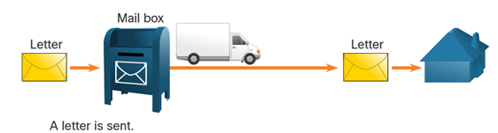
Cont..
IP is Connectionless
IP does not establish a connection with the destination before sending the packet.
There is no control information needed (synchronizations, acknowledgments, etc.).
The destination will receive the packet when it arrives, but no pre-notifications are sent by IP.

Slide 9
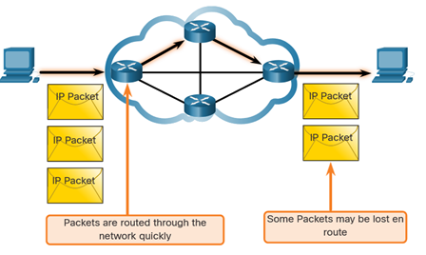
Cont..
IP is Best Effort
IP will not guarantee delivery of the packet.
IP has reduced overhead since there is no mechanism to resend data that is not received.
IP does not expect acknowledgments.
IP does not know if the other device is operational or if it received the packet.

Slide 10
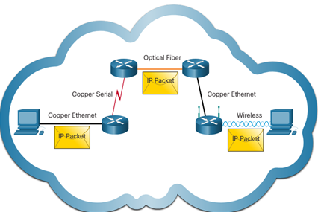
Cont..
IP is unreliable:
It cannot manage or fix undelivered or corrupt packets.
IP cannot retransmit after an error.
IP cannot realign out of sequence packets.
IP must rely on other protocols for these functions.
IP is media Independent:
IP does not concern itself with the type of frame required at the data link layer or the media type at the physical layer.
IP can be sent over any media type: copper, fiber, or wireless.

Slide 11
NIC addressing
Every NIC (Network Interface Card) has a 48-bit globally unique identifier called as MAC address (Media Access Control Address) that is burned into its ROM chip.
This address is a String of usually six sets of two-characters or digits separated by colons.
Example: 00:0a:95:9d:68:16
The MAC address is the physical address.
The MAC address is used to deliver packets to a computer.
The NIC driver software passes the data between the operating system and the NIC.

Slide 12
IP addressing
IP (Internet Protocol address) address is a logical address in the network layer.
It is a series of numbers that identifies any device on a network uniquely.
Example: 192.168.123.132
The Internet addresses are 32 bits in length.
These addresses are referred to as IPv4 (IP version 4) addresses or simply IP addresses.

Slide 13
IPv4
An IPv4 address is a 32-bit address that uniquely and universally defines the connection of a device (for example, a computer or a router) to the Internet.
IPv4 addresses are unique.
They are unique in the sense that each address defines one, and only one, connection to the Internet.
Two devices on the Internet can never have the same address at the same time.
The IPv4 addresses are universal in the sense that the addressing system must be accepted by any host that wants to be connected to the Internet.

Slide 14
Classful Addressing
IPv4 addressing uses the concept of classes.
This architecture is called classful addressing.
In classful addressing, the address space is divided into five classes: A, B, C, D, and E.
Each class occupies some part of the address space.
IPv4 addresses classes are:-
Class A (1.0.0.0/8 to 127.0.0.0/8)
Class B (128.0.0.0 /16 – 191.255.0.0 /16)
Class C (192.0.0.0 /24 – 223.255.255.0 /24)
Class D (224.0.0.0 to 239.0.0.0)
Class E (240.0.0.0 – 255.0.0.0)
Classful addressing wasted many IPv4 addresses.
Classful address allocation was replaced with classless addressing.

Slide 15
Cot..
Class A- IP address belonging to class A are assigned to the networks that contain a large number of hosts.
It has 8 bits long network id
It has 24 bits host id
Default subnet mask is 255.0.0.0
The address range is 1-127
Class B- IP address belonging this class are assigned to the medium-sized to large-sized networks.
It has 16 bits long network id
It has 16 bits host id
Default subnet mask is 255.255.0.0
The address range is 128-191

Slide 16
Cont..
Class C- IP address belonging this class are assigned to the small-sized networks.
It has 24 bits long network id
It has 8 bits host id
Default subnet mask is 255.255.255.0
The address range is 192-223
Class D- IP address belonging this class are reserved for multi-casting.
The address range is 224-239
Class E- IP address belonging this class are reserved for experimental and research purposes.
The address range is 240-255

Slide 17
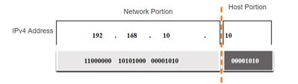
Cont..
An IPv4 address is a 32-bit hierarchical address that is made up of a network portion and a host portion.
When determining the network portion versus the host portion, you must look at the 32-bit stream.
A subnet mask is used to determine the network and host portions.

Slide 18
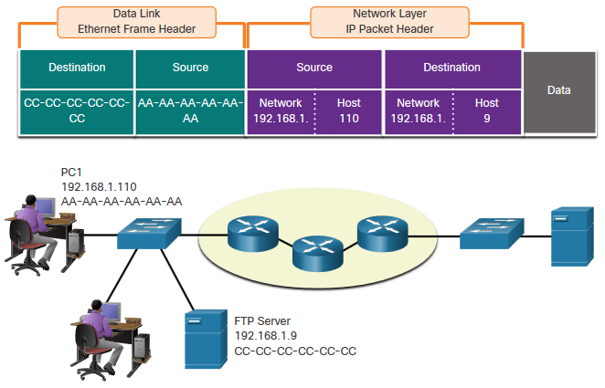
Cont..
Devices on the Same Network
When devices are on the same network the source and destination will have the same number in network portion of the address.
PC1 – 192.168.1.110 PC2 – 192.168.1.20
FTP Server – 192.168.1.9

Slide 19
Cont..
The Subnet Mask
It is a 32 bit number created by setting all host bits to ‘0’and all network bits to ‘1’.
This way the subnet mask separates the IP address in to the network and host addresses.
Class A, B, and C has default subnet masks.
To identify the network and host portions of an IPv4 address, the subnet mask is compared to the IPv4 address bit for bit, from left to right.
The actual process used to identify the network and host portions is called ANDing.

Slide 20
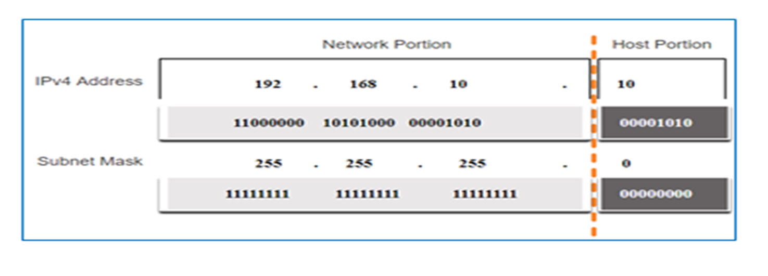
Cont..
In the above example, the IP address is class C.
So that, 192.168.10 is the network portion and 10 is the host portion of the IP address.

Slide 21
Cont..
The Prefix Length
A prefix length is a less cumbersome method used to identify a subnet mask address.
The prefix length is the number of bits set to 1 in the subnet mask.
It is written in “slash notation” therefore, count the number of bits in the subnet mask and prepend it with a slash.

Slide 22
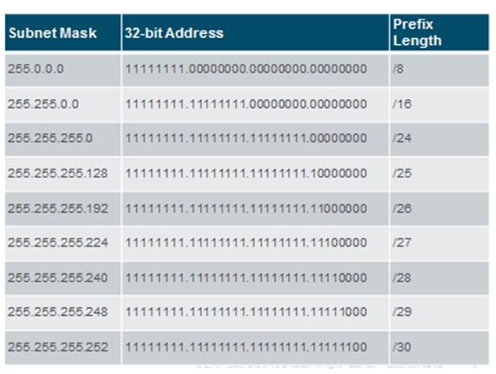
Cont..

Slide 23
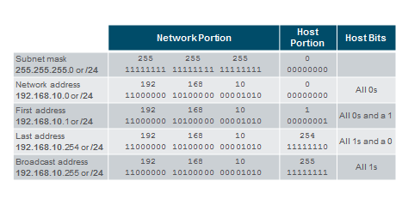
Cont..
Network, Host, and Broadcast Addresses
Within each network are three types of IP addresses:
Network address
Host addresses
Broadcast address

Slide 24
Cont..
Determining the Network: Logical AND
A logical AND Boolean operation is used in determining the network address.
Logical AND is the comparison of two bits where only a 1 AND 1 produces a 1 and any other combination results in a 0.
1 AND 1 = 1, 0 AND 1 = 0, 1 AND 0 = 0, 0 AND 0 = 0
1 = True and 0 = False
To identify the network address, the host IPv4 address is logically ANDed, bit by bit, with the subnet mask to identify the network address.

Slide 25
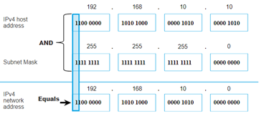
Cont..

Slide 26
Cont..
192.168.5.85/24
The network address/id is 192.168.5.0
The first usable host is 192.168.5.1
The last usable host is 192.168.5.254
The braodcast address is 192.168.5.255

Slide 27
Convert Binary to Decimal
Convert 11000000.10101000.00001011.00001010 to decimal.
Positional Value | 128 | 64 | 32 | 16 | 8 | 4 | 2 | 1
Binary Number (11000000) | 1 | 1 | 0 | 0 | 0 | 0 | 0 | 0
Calculate | 1x128 | 1x64 | 0x32 | 0x16 | 0x8 | 0x4 | 0x2 | 0x1
Add Them Up… | 128 | + 64 | + 0 | + 0 | + 0 | + 0 | + 0 | + 0
Binary Number (10101000) | 1 | 0 | 1 | 0 | 1 | 0 | 0 | 0
Calculate | 1x128 | 0x64 | 1x32 | 0x16 | 1x8 | 0x4 | 0x2 | 0x1
Add Them Up… | 128 | + 0 | + 32 | + 0 | + 8 | + 0 | + 0 | + 0
Binary Number (00001011) | 0 | 0 | 0 | 0 | 1 | 0 | 1 | 1
Calculate | 0x128 | 0x64 | 0x32 | 0x16 | 1x8 | 0x4 | 1x2 | 1x1
Add Them Up… | 0 | + 0 | + 0 | + 0 | + 8 | + 0 | + 2 | + 1
Binary Number (00001010) | 0 | 0 | 0 | 0 | 1 | 0 | 1 | 0
Calculate | 0x128 | 0x64 | 0x32 | 0x16 | 1x8 | 0x4 | 1x2 | 0x1
Add Them Up… | 0 | + 0 | + 0 | + 0 | + 8 | + 0 | + 2 | + 0
192
168
11
10
192.168.11.10

Slide 28
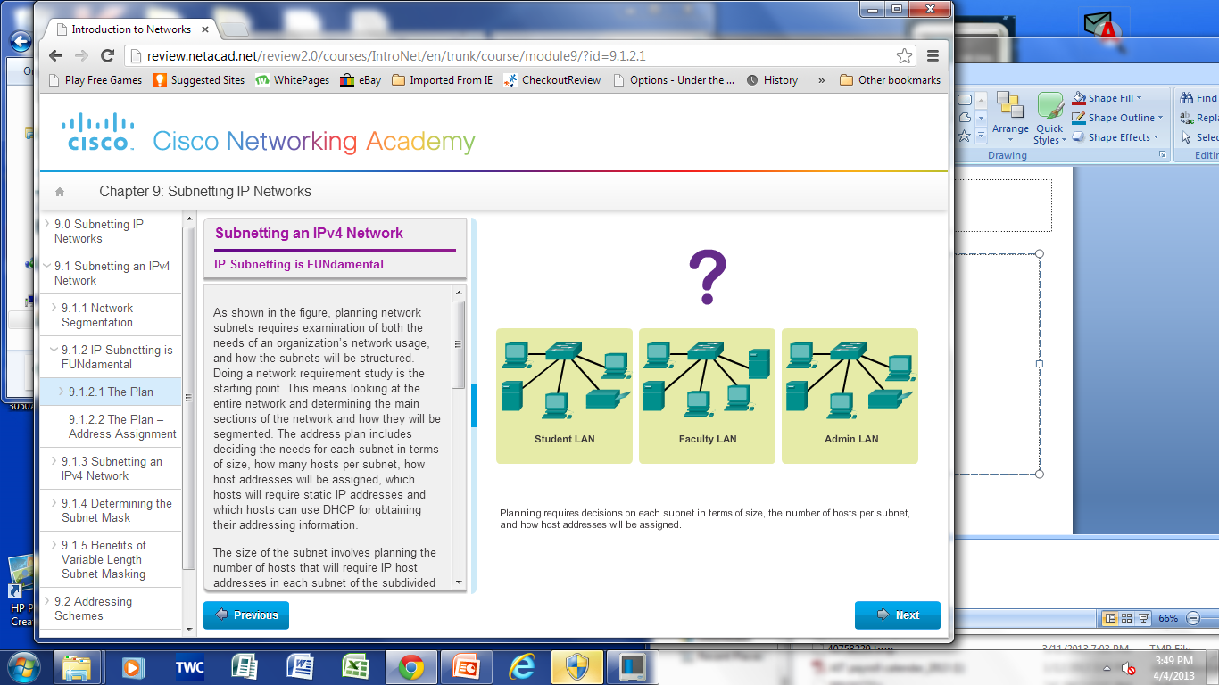
Subnetting
Subnetting is a process of dividing or segmenting a network into smaller networks called subnets.
A subnet or a subnetwork is a segmented piece of a larger network.
If an organization was granted a large block in class A or B, it could divide the addresses into several contiguous groups and assign each group to smaller networks (called subnets).
or, in rare cases, share part of the addresses with neighbors.

Slide 29
Reasons for Subnetting
Large networks need to be segmented into smaller sub-networks, creating smaller groups of devices and services in order to:
Control traffic by containing broadcast traffic within subnetwork
Reduce overall network traffic and improve network performance
Communication Between Subnets
A router is necessary for devices on different networks and subnets to communicate.
Each router interface must have an IPv4 host address that belongs to the network or subnet that the router interface is connected to.
Devices on a network and subnet use the router interface attached to their LAN as their default gateway.

Slide 30
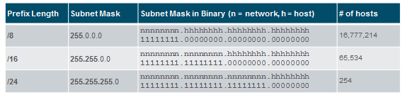
Subnetting cont..
Networks are most easily subnetted at the octet boundary of /8, /16, and /24.
Notice that using longer prefix lengths decreases the number of hosts per subnet.

Slide 31
Cont..
Example
192.168.5.85
This address is a class C address. Its default subnet mask is 255.255.255.0.
Or it could be written as 192.168.5.85/24. this shows 24 bits are network portion.
Binary of 192.168.5.85 and 255.255.255.0 are 11000000.10101000.00000101.01010101 11111111.11111111.11111111.00000000
By Anding these two, we get 11000000.10101000.00000101.00000000 = 192.168.5.0
This is the network address and 192.168.5.255 is the broadcast address.
192.168.5.1 - 192.168.5.254 will be the usable host address range.

Slide 32
Cont..
Formulas for Subnet Calculation
Possible Number of Subnets
To calculate the number of possible subnets, use the formula 2^{n}, where n equals the number of host bits borrowed.
For example, if three host bits are borrowed, then n=3.
2³ = 8, so eight subnets are possible if three host bits are borrowed.
Possible Number of Hosts per Subnet
To calculate the number of possible hosts per subnet, use the formula 2^{h}, where h equals the number of host bits.
Possible Number of usable Hosts per Subnet
To calculate the number of possible hosts per subnet, use the formula 2^{h} - 2, where h equals the number of host bits.
The reason two addresses must be subtracted is because of the network address and the broadcast address.

Slide 33
Cont..
In order to create IP subnets, host bits are changed to network bits.
This is often called borrowing bits.
It is also often referred to as taking host bits and giving them to the network.
By borrowing host bits, more IP subnets are created, but each subnet can support fewer hosts.
To change a host bit to a network bit, the subnet mask must be changed.
Remember, a binary 0 in the subnet mask means that bit is part of the host portion of an IP address. A binary 1 in the subnet mask means that bit is part of the network portion of an IP address.
So, to change a bit from a host bit to a network bit, the binary value of the bit must be changed from 0 to 1 in the subnet mask.

Slide 34
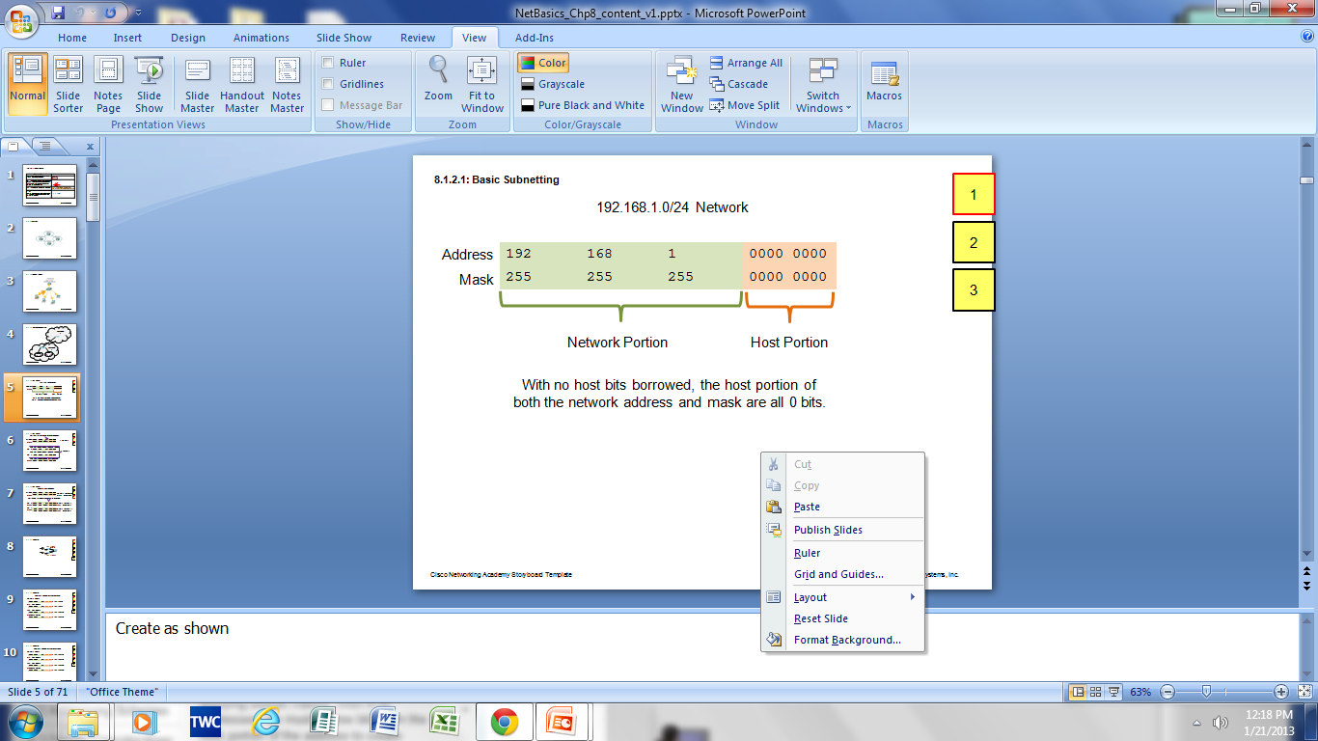
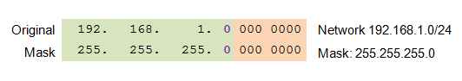
Cont..
Borrowing Bits to Create Subnets
Borrowing 1 bit 2¹ = 2 subnets
Subnet 0
Network 192.168.1.0-127/25
Mask: 255.255.255.128
Subnet 1
Network 192.168.1.128-255/25
Mask: 255.255.255.128

Slide 35
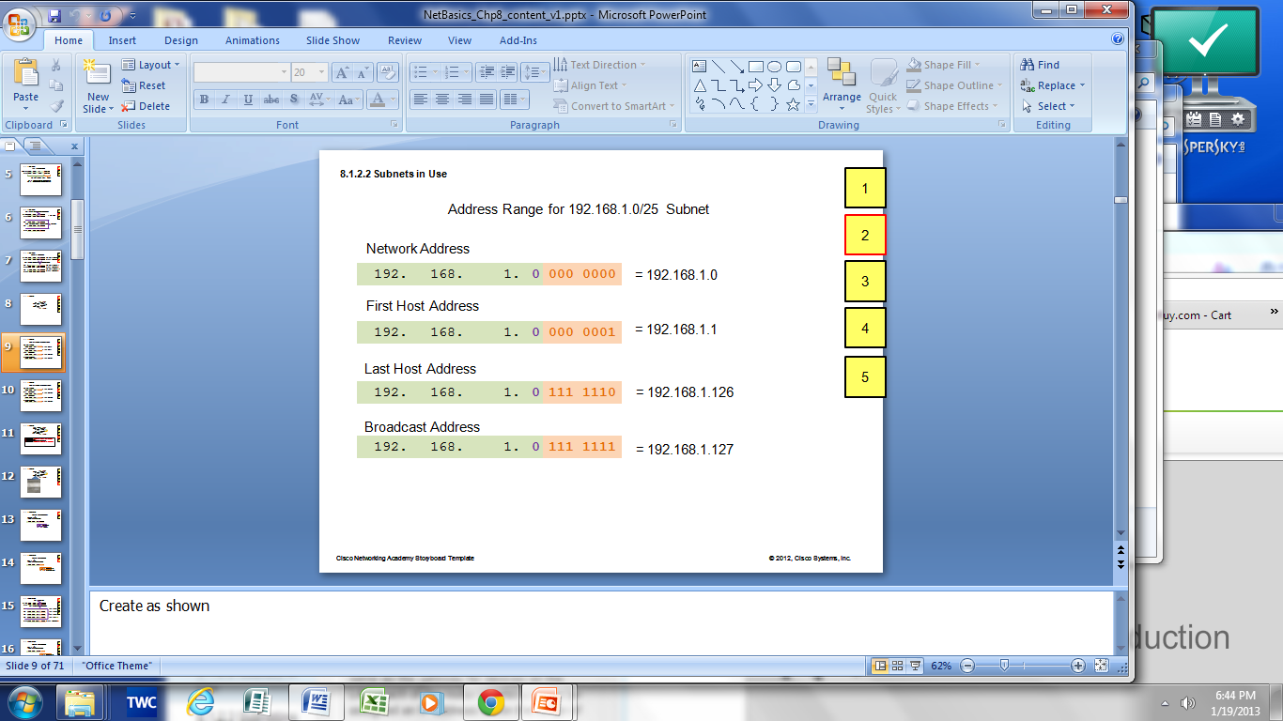
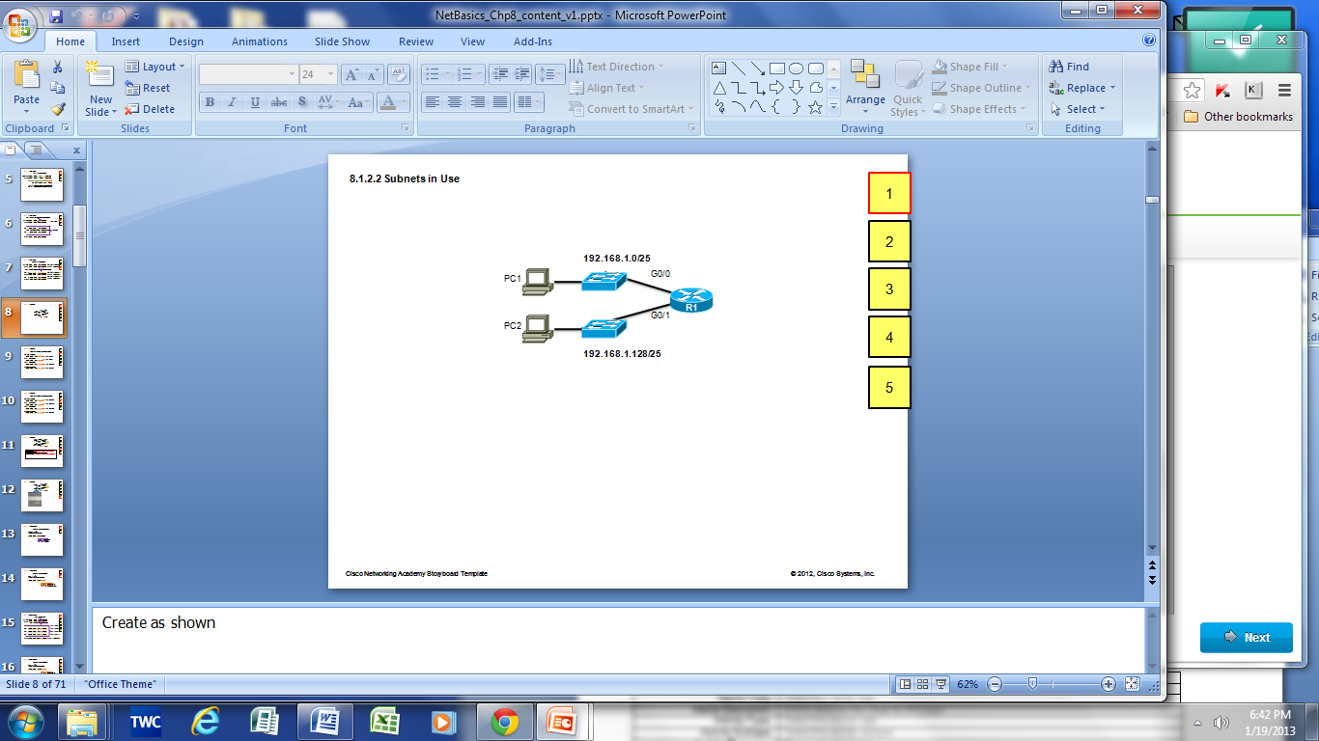

Cont..
192.168.1.0/25
Subnet 0
Network 192.168.1.0-127/25
Subnet 1
Network 192.168.1.128-255/25

Slide 36
Cont..
It is important to balance the number of subnets needed and the number of hosts required for the largest subnet.
Design the addressing scheme to accommodate the maximum number of hosts for each subnet.
Allow for growth in each subnet.

Slide 37
Cont..
Example
Number of needed subnets 14 Number of needed usable hosts 10 Network Address 192.10.10.0
No of subnets 2^{n} = 2⁴ = 16
No of hosts 2^{h} = 2⁴ = 16
No of usable hosts = no of hosts – 2 = 16 -2 = 14
Network id usable host range broadcast address
Subnet 1-> 192.10.10.0 192.10.10.1-192.10.10.14 192.10.10.15
Subnet 2-> 192.10.10.16 192.10.10.17-192.10.10.30 192.10.10.31
Subnet 3-> 192.10.10.32 192.10.10.33-192.10.10.46 192.10.10.47
Subnet 4-> 192.10.10.48 192.10.10.49-192.10.10.62 192.10.10.63

Slide 38
Cont..
Subnet 5-> 192.10.10.64 192.10.10.65-192.10.10.78 192.10.10.79
Subnet 6-> 192.10.10.80 192.10.10.81-192.10.10.94 192.10.10.95
Subnet 7-> 192.10.10.96 192.10.10.97-192.10.10.110 192.10.10.111
Subnet 8-> 192.10.10.112 192.10.10.113-192.10.10.126 192.10.10.127
Subnet 9-> 192.10.10.128 192.10.10.129-192.10.10.142 192.10.10.143
Subnet 10-> 192.10.10.144 192.10.10.145-192.10.10.158 192.10.10.159
Subnet 11-> 192.10.10.160 192.10.10.161-192.10.10.174 192.10.10.175
Subnet 12-> 192.10.10.176 192.10.10.177-192.10.10.190 192.10.10.191
Subnet 13-> 192.10.10.192 192.10.10.193-192.10.10.206 192.10.10.207
Subnet 14-> 192.10.10.208 192.10.10.209-192.10.10.222 192.10.10.223
Subnet 15-> 192.10.10.224 192.10.10.225-192.10.10.238 192.10.10.239
Subnet 16-> 192.10.10.240 192.10.10.241-192.10.10.254 192.10.10.255

Slide 39
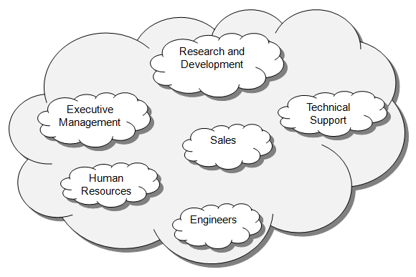
Subnetting Based on Host Requirements
There are two considerations when planning subnets:
Number of Subnets required
Number of Host addresses required
Calculate number of subnets
Formula 2^{n} (where n is the number of bits borrowed)
Subnet needed for each
department in graphic

Slide 40
Example
You have been given the network address 192.168.10.0/25 by your customer. Based on this information, answer the ff questions.
Find the subnet mask?
Find the total number of network can be created?
Find the total number of IP address on each network?
Find the total number of host on each network?
Find the first usable host IP address and the last usable host IP address on each network?

Slide 41
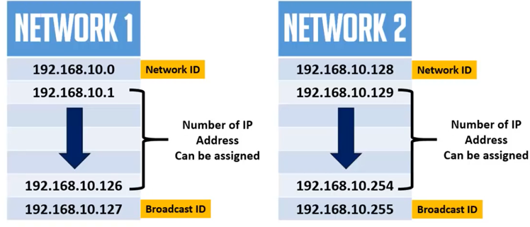
Solution:-
Number of network: 2^{n}
Total number of bits borrowed from host)
2¹=2
Number of IP add on each network: 2^{n}
Total number of host bits)
2⁷⁼128
Number of hosts on each network: 2^{n}-2
Total number of remaining host bits)
2⁷-2=126

Slide 42
Exercise
You have been given the network address 192.168.10.0/28 from EthioTelecom. Based on this information, answer the following questions.
Find the subnet mask?
Find the total number of network can be created?
Find the total number of IP address on each network?
Find the total number of host on each network?
Find the first usable host IP address and the last usable host IP address on each network?

Slide 43
Cont..
Traditional Subnetting Wastes Addresses
Traditional subnetting - same number of addresses is allocated for each subnet.
Subnets that require fewer addresses have unused (wasted) addresses.
Variable Length Subnet Mask (VLSM) or subnetting a subnet provides more efficient use of addresses.

Slide 44
Variable Length Subnet Masks (VLSM)
VLSM allows a network space to be divided in unequal parts.
Subnet mask will vary depending on how many bits have been borrowed for a particular subnet.
Network is first subnetted, and then the subnets are subnetted again.
Process repeated as necessary to create subnets of various sizes.
Using VLSM subnets, the network segments can be addressed with minimum waste.

Slide 45
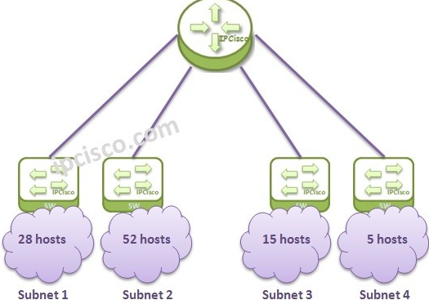
Example
192.168.1.0/24 IP Address.
Subnet 1 = 28 hosts Subnet 2 = 52 hosts Subnet 3 = 15 host Subnet 4 = 5 hosts

Slide 46
Cont..
To overcome this Subnetting issue, firstly we determine the host bits for each subnet.
For the first subnet; we need 5 host bits. With 5 bits we can have 2⁵=32 addresses. This means that there are 32-2 usable host addresses.
For the second subnet; we need 6 host bits. With 6 bits we can have 2⁶=64 addresses. This means that there are 64-2 usable host addresses.
For the third subnet; we need 5 host bits. With 5 bits we can have 2⁵=32 addresses…
For the fourth subnet; we need 3 host bits. With 3 bits we can have 2³=8 addresses. This means that there are 8-2 usable host addresses.

Slide 47
Cont..
If we use /26 with 192.168.1.0 like 192.168.1.0/26, then we will have 4 subnets. The given Subnet was 24 and our new subnet is 26. 26-24=2 and 2²=4 subnets.
192.168.1.0/26 192.168.1.64/26 192.168.1.128/26 192.168.1.192/26
We will use the first one for the Subnet 2. (192.168.1.0/26)
Now, for the first and third subnet, let’s use the second block (192.168.1.64/26) and divide it again.
If we divide it by borrowing a bit again, then we will have two subnets.
192.168.1.64/27 192.168.1.96/27

Slide 48
Cont..
We can use these two Prefixes for first and second subnet.
And lastly, for the small subnet, we can use the above third block(192.168.10.128/26).
We will divide it again.
Because we need only 5 host address.
When we divide again, we will have the below small subnets, and we can use the first one for our fourth and last Subnet.
192.168.1.128/29 192.168.1.136/29 192.168.1.144/29 192.168.1.152/29 192.168.1.160/29 192.168.1.168/29 192.168.1.176/29 192.168.1.184/29

Slide 49
Cont..
we have used our IP Block very efficiently. The unused remaining blocks can be used in the future. What are these remaining blocks let’s remember. The remaining blocks are the last block of /26 subnets and the last 7 block of /29 subnets.
At the end our subnets will be like below:
192.168.1.0/26 192.168.1.64/27 192.168.1.96/27 192.168.1.128/29

Slide 50
Classless Addressing
Formal name is Classless Inter-Domain Routing (CIDR, pronounced “cider.
Created a new set of standards that allowed service providers to allocate IPv4 addresses on any address bit boundary (prefix length) instead of only by a class A, B, or C address.
CIDR or Classless Inter Domain Routing provides the flexibility of borrowing bits of Host part of the IP address and using them as Network in Network, called Subnet.
Eg.
190.79.18.70/18
This address is a traditional class B and its default subnet mask is 255.255.0.0. but it has 25 network bits that are all 1. therefore the subnet mask will be 255.255.192.0.

Slide 51
Supernetting
It is inverse of subnetting
Combining of multiple networks to single networks
Converting network bits to hosts bits i.e. converting 1’s into 0’s
It is also known as classless inter domain routing(CIDR)
Benefit of supernetting
Reduce the network traffic
To minimize the routing table
Steps:
Write all numbers in binary
Find matching bits left to write upto match
Write them upto match and 0 upto end (New Network ID)
Make all 1 upto match and zero upto end (New Mask)

Slide 52
Example
192.168.0.0/24
192.168.1.0/24
192.168.2.0/24
192.168.3.0/24
Step 1 and 2
11000000.10101000.00000000.00000000
11000000.10101000.00000001.00000000
11000000.10101000.00000010.00000000
11000000.10101000.00000011.00000000
Step 3
11000000.10101000.00000000.00000000
192.168.0.0 (New Network ID)
Step 4
11111111.11111111.11111100.00000000
255.255.252.0 (New Mask ID)
192.168.0.0/22 (New Network)

Slide 53
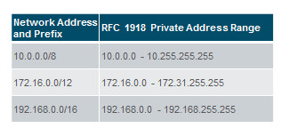
Private and Public IP addresses
As defined in in RFC 1918, public IPv4 addresses are globally routed between internet service provider (ISP) routers.
Private addresses are common blocks of addresses used by most organizations to assign IPv4 addresses to internal hosts.
Private IPv4 addresses are not unique and can be used internally within any network.
However, private addresses are not globally routable.

Slide 54
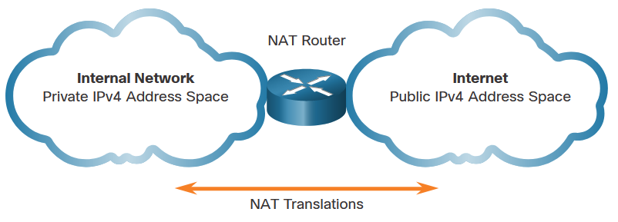
Routing in the Internet
Networks are commonly implemented using private IPv4 addresses, as defined in RFC 1918.
Private IPv4 addresses cannot be routed over the internet and are used within an organization or site to allow devices to communicate locally.
To allow a device with a private IPv4 address to access devices and resources outside of the local network, the private address must first be translated to a public address.
NAT(Network Address Translation) provides the translation of private addresses to public addresses.
Class | Activity Type | Activity Name
A | 10.0.0.0 – 10.255.255.255 | 10.0.0.0/8
B | 172.16.0.0 – 172.31.255.255 | 172.16.0.0/12
C | 192.168.0.0 – 192.168.255.255 | 192.168.0.0/16

Slide 55
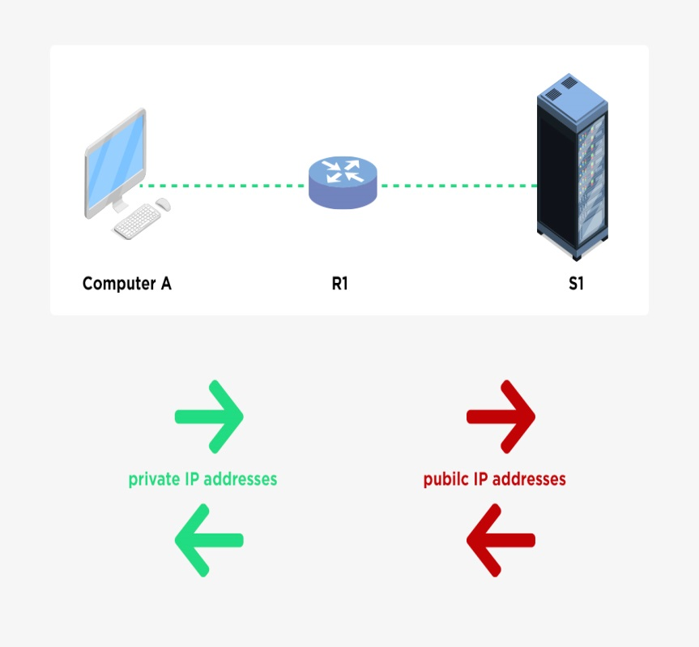
Network Address Translation(NAT)
It is a way to map local private addresses to a public address before transferring the information.
It is designed for IP address conservation.
It enables private IP addresses to connect to the internet.
NAT operates on a router.
The three reserved ranges are:
10.0.0.0 – 10.255.255.255/8 (16,777,216 hosts)
172.16.0.0 – 172.31.255.255/12 (1,048,576 hosts)
192.168.0.0 – 192.168.255.255/16 (65,536 hosts)
It enables private IP networks that use unregistered IP addresses to connect to the Internet.
NAT operates on a router, usually connecting two networks together, and translates the private (not globally unique) addresses in the internal network into legal addresses, before packets are forwarded to another network.

Slide 56
Cont..
Types of NAT
1. Static NAT
When the local address is converted to a public one, static NAT chooses the same one.
This means there will be a consistent public IP address associated with that router or NAT device.
2. Dynamic NAT
Instead of choosing the same IP address every time, dynamic NAT goes through a pool of public IP addresses.
This results in the router or NAT device getting a different address each time the router translates the local address to a public address.

Slide 57
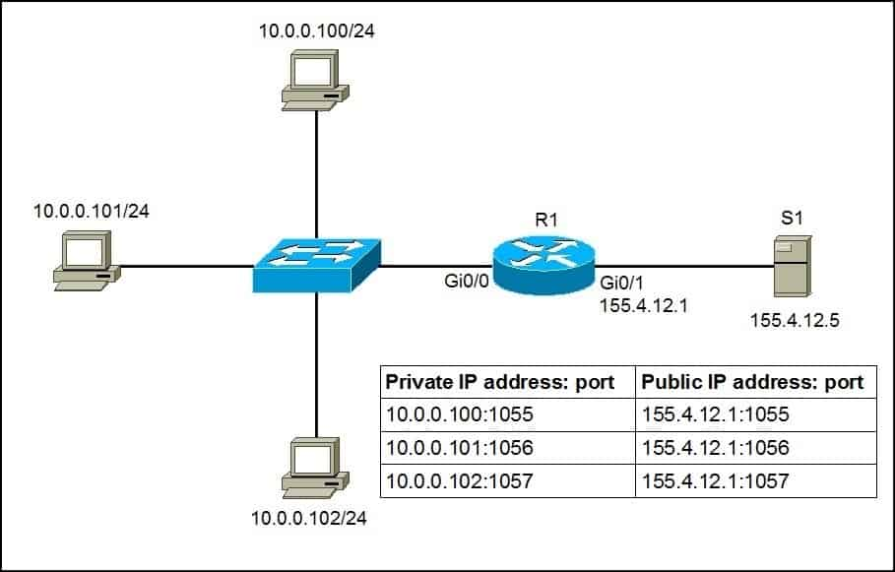
Port address translation (PAT)
It is an extension to NAT.
It permits multiple devices on the local area network to be mapped to a single public IP address.
In PAT, Private IP addresses are translated into the public IP address via Port numbers.
PAT also uses IPv4 address but with port number.

Slide 58
Address Mapping
Address mapping is the process of determining the physical address by knowing the logical address of the device and vice versa.
Address mapping is required when a packet is routed from source host to destination host in the same or different network.
Static mapping
In static mapping, each device connected to the network maintains a table i.e., routing table which has a list of all the routes from that device to a particular network or hosts.
It maintains the network/next hop association i.e., the logical address of next-hop and its corresponding physical address.

Slide 59
Cont..
Dynamic Mapping
In dynamic mapping usually, the source host knows the logical address of the destination host
but to deliver the packet to the destined host its physical address is required, as at the physical level the device is identified by its physical address.
The source knows one or two addresses and it can find the rest using mapping protocols.

Slide 60
Logical to Physical Address Mapping –ARP
Address Resolution Protocol (ARP)
It is a network layer protocol used to do address resolution or address mapping.
Its purpose is to find the MAC address of a device in LAN for a corresponding IP address which a network application is trying to communicate.
A device uses ARP to determine the destination MAC address of a local device when it knows its IPv4 address.
When the destination IP address is on a remote network, the destination MAC address is that of the default gateway.
ARP provides two basic functions:
Resolving IPv4 addresses to MAC addresses
Maintaining an ARP table of IPv4 to MAC address mappings

Slide 61
ARP functions
To send a frame, a device will search its ARP table for a destination IPv4 address and a corresponding MAC address.
If the packet’s destination IPv4 address is on the same network, the device will search the ARP table for the destination IPv4 address.
If the destination IPv4 address is on a different network, the device will search the ARP table for the IPv4 address of the default gateway.
If the device locates the IPv4 address, its corresponding MAC address is used as the destination MAC address in the frame.
If there is no ARP table entry is found, then the device sends an ARP request.

Slide 62
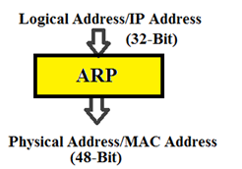
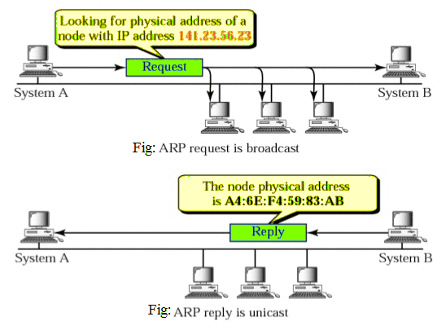

Slide 63
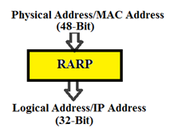
Physical to Logical Address Mapping –RARP
Reverse Address Resolution Protocol (RARP)
Its reverse ARP.
Opposite to ARP.
It is also known as a network layer protocol that is used to do address resolution or address mapping.
Its purpose is to find the logical address or the IP address that only knows its MAC address.

Slide 64
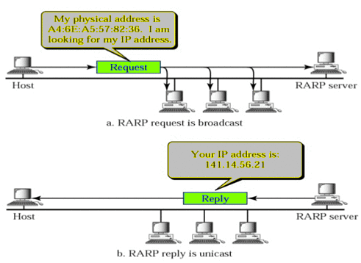
Cont..

Slide 65
ICMP
The Internet Control Message Protocol (ICMP) is a protocol that devices within a network use to communicate problems with data transmission.
One of the primary ways in which ICMP is used is to determine if data is getting to its destination and at the right time.
This makes ICMP an important aspect of the error reporting process and testing to see how well a network is transmitting data.

Slide 66
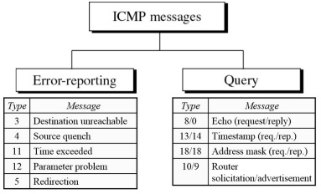
Types of Messages

Slide 67
Cont..
Error Reporting Messages
These are messages which are sent when an error is reported by ICMP protocol.
Some of common messages under this category are as follows:
Destination Unreachable (Type 3)
One of the most common error reporting messages occurs when the router is unable to locate the path of the packet where it is needed to be delivered and in this case the packet also gets discarded and this message is sent to the source.
Redirect (Type 5)
This ICMP error message occurs whenever there is a request that demands redirection means there is a router called Gateway that has the information of other routers and based on the destination the packet is sent to the correct router.

Slide 68
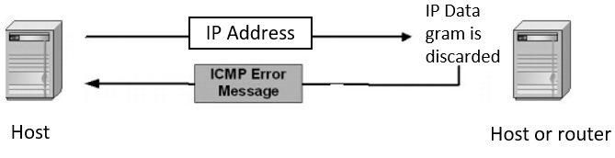
Cont..
But sometimes the packet that is needed to be sent to a router is not in the gateway router information directly.
It needs to get the address of that router from the routers mentioned in its table.
So as soon as it gets that address it gives the redirect message to the host so that host can directly send the message to that given address.

Slide 69
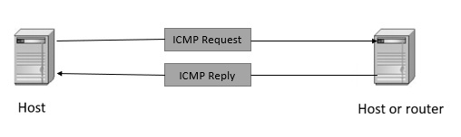
Cont..
Query Messages
These are messages which are sent when ICMP queries about the status of the host.
Some of common messages under this category are as follows
Echo Request (Type 8) & Echo reply (Type 0)
This pair of messages determines whether a given host can connect to a given destination by generating the echo request and echo reply messages. These are used simply to diagnose a network connection between sender and destination.
Time-stamp Request (Type 13) & Time stamp Reply (Type14)
These message pairs record the time taken by a host or router to reach another host or router by generating the time-stamp request and time-stamp reply messages where the difference between the 2 timestamps can tell the time
taken to reach from one host
to another.

Slide 70
ICMPv6
The Internet Control Message Protocol Version 6 (ICMPv6) is a new version of the ICM protocol that forms an integral part of the Internet Protocol version 6 (IPv6) architecture.
ICMPv6 is a multipurpose protocol and is used for a variety of activities including error reporting in packet processing, diagnostic activities, Neighbor Discovery process and IPv6 multicast membership reporting.
ICMP is available for both IPv4 and IPv6. ICMPv4 is the messaging protocol for IPv4.
ICMPv6 provides these same services for IPv6 but includes additional functionality.

Slide 71
IGMP
The Internet Group Management Protocol (IGMP) is a protocol that allows several devices to share one IP address so they can all receive the same data.
IGMP is a network layer protocols used to set up multicasting on networks that use the Internet Protocol version 4 (IPv4).
Specifically, IGMP allows devices to join a multicasting group.
IGMP can be used for one-to-many networking applications such as online streaming video and gaming, and allows more efficient use of resources when supporting these types of applications.
IGMP is used on IPv4 networks.

Slide 72
IGMP Messages
The IGMP protocol allows for several kinds of IGMP messages:
Membership reports: Devices send these to a multicast router in order to become a member of a multicast group.
"Leave group" messages: These messages go from a device to a router and allow devices to leave a multicast group.
General membership queries: A multicast-capable router sends out these messages to the entire connected network of devices to update multicast group membership for all groups on the network.

Slide 73
IGMP Operation
Computers and other devices connected to a network use IGMP when they want to join a multicast group.
A router that supports IGMP listens to IGMP transmissions from devices in order to figure out which devices belong to which multicast groups.
IGMP uses IP addresses that are set aside for multicasting.
Multicast IP addresses are in the range between 224.0.0.0 and 239.255.255.255.
Each multicast group shares one of these IP addresses.
When a router receives a series of packets directed at the shared IP address, it will duplicate those packets, sending copies to all members of the multicast group.
IGMP multicast groups can change at any time.
A device can send an IGMP "join group" or "leave group" message at any point.
IGMP works directly on top of the Internet Protocol (IP).
Each IGMP packet has both an IGMP header and an IP header.

Slide 74
Routing and forwarding
Forwarding refers to the router-local action of transferring packet from an input link interface to the appropriate output link interface.
When a packet arrives at a router’s input link, the router must move the packet to the appropriate output link.
For example, a packet arriving from Host H1 to Router R1 must be forwarded to the next router on a path to H2.
Routing refers to the network-wide process that determines the end-to-end paths that packets take from source to destination.
The network layer must determine the route or path taken by packets as they flow from a sender to a receiver.
The algorithms that calculate these paths are referred to as routing algorithms.
A routing algorithm would determine, for example, the path along which packets flow from H1 to H2.

Slide 75
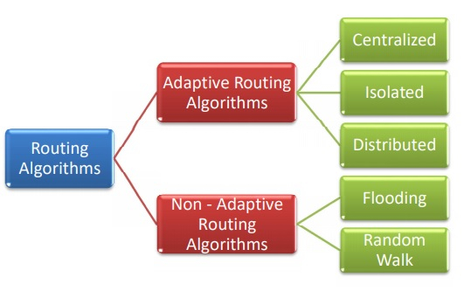
Routing algorithms

Slide 76
Cont..
Adaptive Routing Algorithms
Adaptive routing algorithms, also known as dynamic routing algorithms, makes routing decisions dynamically depending on the network conditions.
It constructs the routing table depending upon the network traffic and topology.
They try to compute the optimized route depending upon the hop count, transit time and distance.
The three popular types of adaptive routing algorithms are −
Centralized algorithm − It finds the least-cost path between source and destination nodes by using global knowledge about the network. So, it is also known as global routing algorithm.
Isolated algorithm − This algorithm procures the routing information by using local information instead of gathering information from other nodes.
Distributed algorithm − This is a decentralized algorithm that computes the least-cost path between source and destination iteratively in a distributed manner.

Slide 77
Cont..
Non – Adaptive Routing Algorithms
Non-adaptive Routing algorithms, also known as static routing algorithms, construct a static routing table to determine the path through which packets are to be sent.
The static routing table is constructed based upon the routing information stored in the routers when the network is booted up.
The two types of non – adaptive routing algorithms are −
Flooding − In flooding, when a data packet arrives at a router, it is sent to all the outgoing links except the one it has arrived on. Flooding may be uncontrolled, controlled or selective flooding.
Random walks − This is a probabilistic algorithm where a data packet is sent by the router to any one of its neighbors randomly.

Slide 78
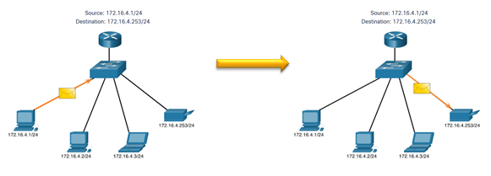
Unicasting, Multicasting and Broadcasting
Unicast
Unicast transmission is sending a packet to one destination IP address.
For example, the PC at 172.16.4.1 sends a unicast packet to the printer at 172.16.4.253.

Slide 79
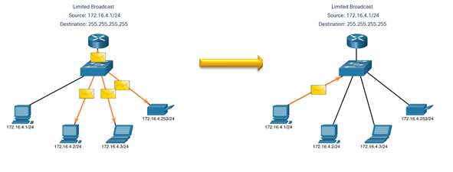
Cont..
Broadcast
Broadcast transmission is sending a packet to all other destination IP addresses.
For example, the PC at 172.16.4.1 sends a broadcast packet to all IPv4 hosts.

Slide 80
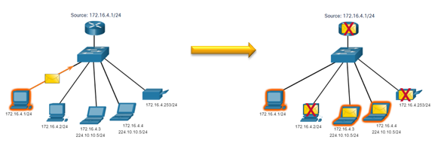
Cont..
Multicast
Multicast transmission is sending a packet to a multicast address group.
For example, the PC at 172.16.4.1 sends a multicast packet to the multicast group address 224.10.10.5.

Slide 81
IPv6
IPv4 has three major limitations:
IPv4 address depletion – We have basically run out of IPv4 addressing.
Lack of end-to-end connectivity – To make IPv4 survive this long, private addressing and NAT were created. This ended direct communications with public addressing.
Increased network complexity – NAT was meant as temporary solution and creates issues on the network as a side effect of manipulating the network headers addressing. NAT causes latency and troubleshooting issues.

Slide 82
Cont..
IPv6 was developed by Internet Engineering Task Force (IETF).
IPv6 overcomes the limitations of IPv4.
Improvements that IPv6 provides:
Increased address space – based on 128 bit address, not 32 bits
Improved packet handling – simplified header with fewer fields
Eliminates the need for NAT – since there is a huge amount of addressing, there is no need to use private addressing internally and be mapped to a shared public address

Slide 83
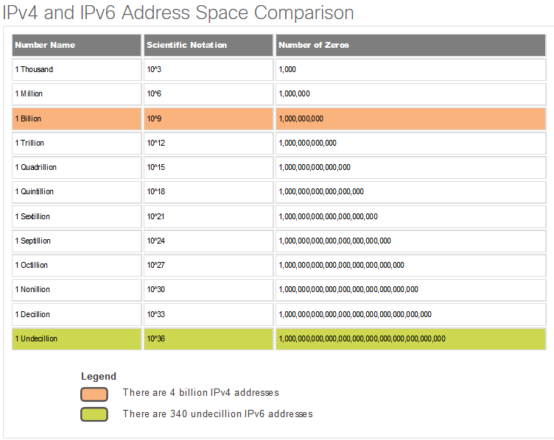
Cont..

Slide 84
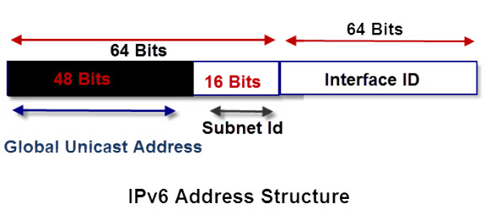
IPv6 Structure
An IPv6 address is 128 bits long and is arranged in eight groups, each of which is 16 bits.
Each group is expressed as four hexadecimal digits and the groups are separated by colons.
An example of a full IPv6 address could be:
FE80:CD00:0000:0CDE:1257:0000:211E:729C
An IPv6 address is split into two parts: a network and a node/host component.
The network component is the first 64 bits of the address and is used for routing.
The node component is the later 64 bits and is used to identify the address of the interface.

Slide 85
End of chapter 4

